Slide 1
Millimeter-Scale Robot Cable Assembly
Animal Inspired Movement and Robotics Lab
University of Colorado Boulder

Slide 2
Contact Information
Parker McDonnell
Parker.mcdonnell@colorado.edu
207-610-2211
PI: Kaushik Jayaram
Kaushik.Jayaram@colorado.edu
CU Boulder
Paul M. Rady Mechanical Engineering
1111 Engineering Drive, UCB 427
Boulder, CO 80309

Slide 3
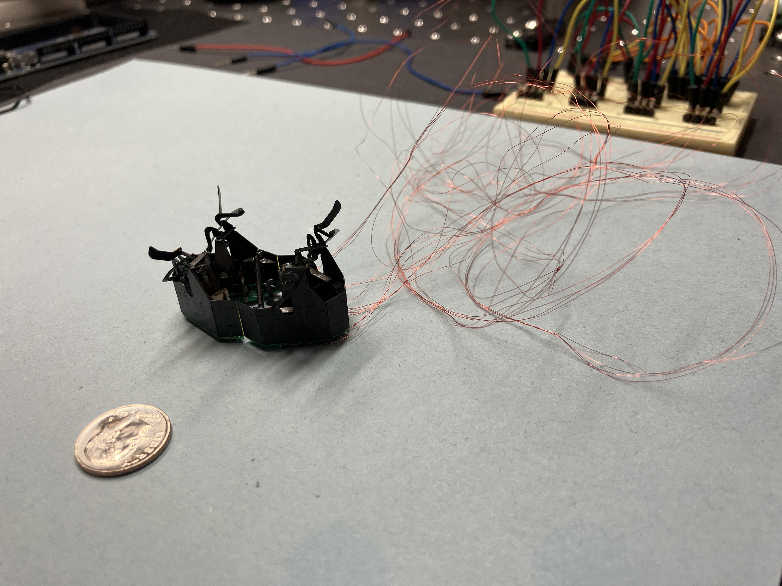
Millimeter-Scale Robot Cabling Needs
Need: detachable cable for connecting mm-scale robot to test equipment
Test equipment
Extremely light weight and complaint cable.
Connectorized for easy installation and disconnection from robot and test equipment.
Needs to connect 20-24 signals.
Needs to withstand 200V signaling.
Mm-scale robot
Current 46 AWG magnet wire cabling

Slide 4
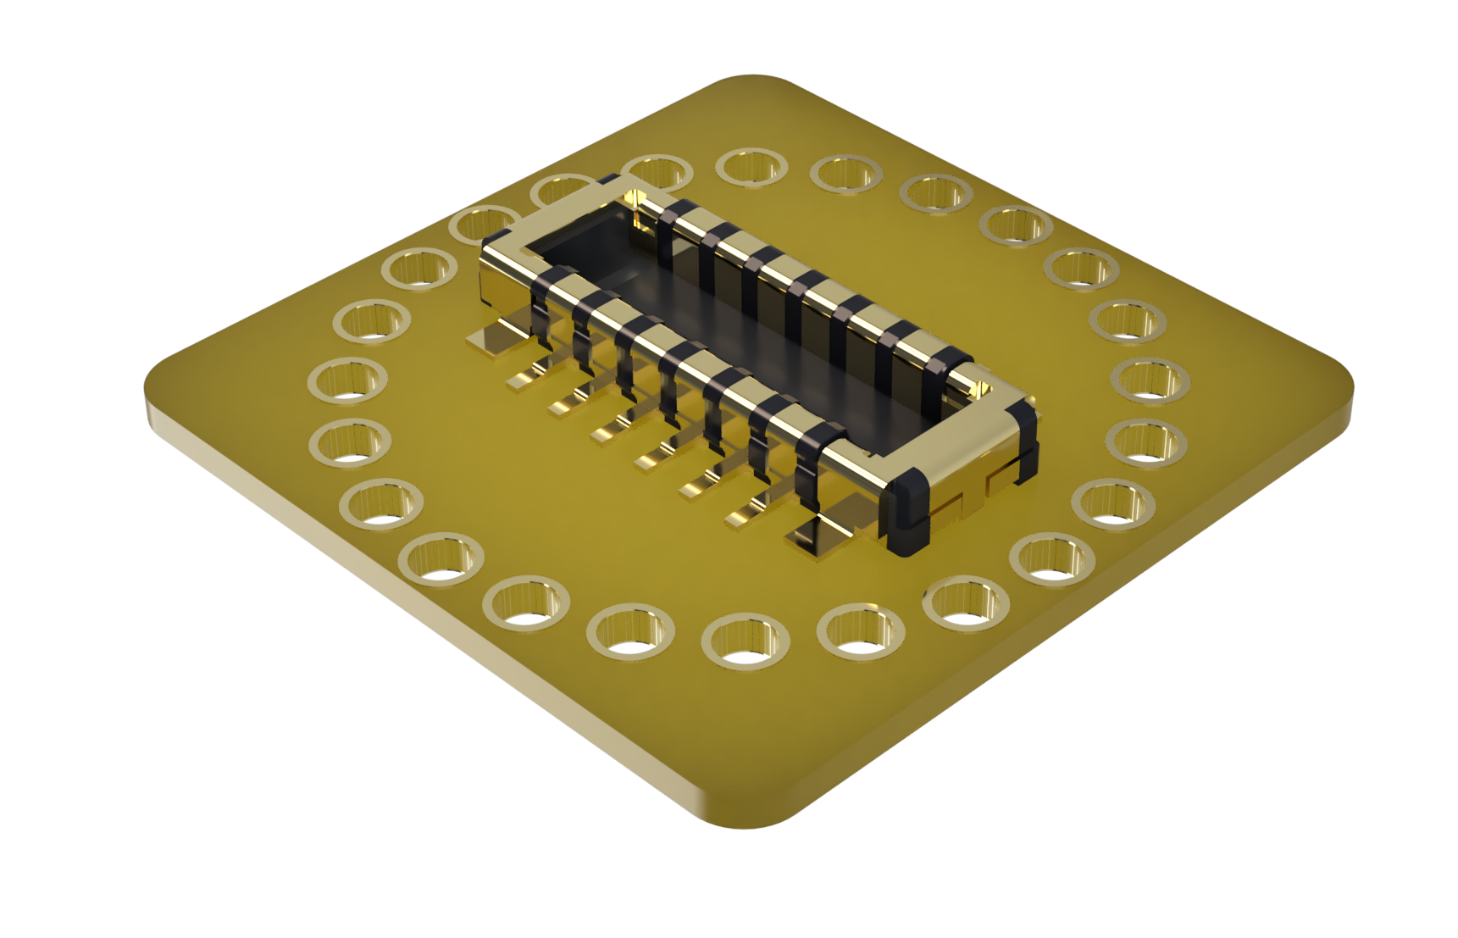
Millimeter-Scale Robot Cabling Flex PCB Concept
5x5 mm flex PCB with 20 or 24 pin mezzanine connector
Mezzanine connector (to other PCB)
Thru-hole Vias for soldering magnet wire
Flex PCB with mezzanine connector for interfacing to flex PCBs (one on test equipment, one on robot).
20 – 24 through hole vias for soldering magnet wire.
PCB with connector will be Provided by our lab
Flex PCB (5x5mm)
Note: The rendered connector is only 12 pins. The real version will have 20 or 24 pins.

Slide 5
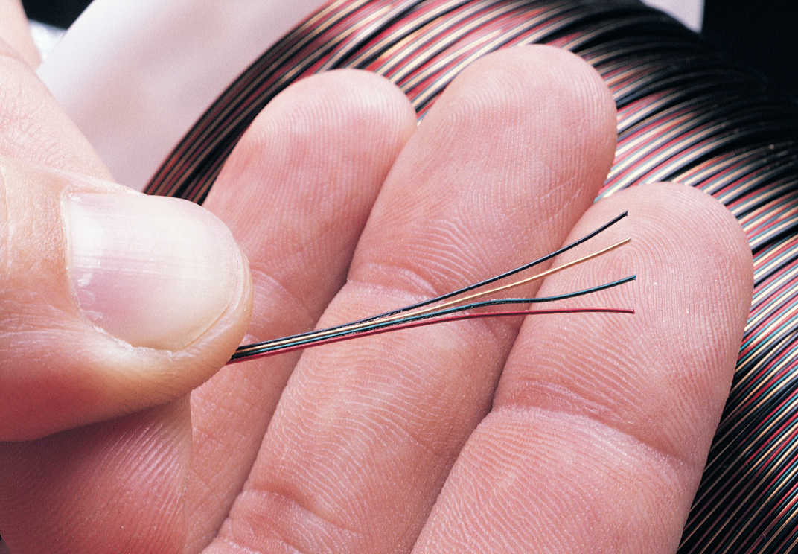
Millimeter-Scale Robot Cabling
Conductors: 20-24 wires
Gauge: 46 AWG
Enamel: Polyamide
Length: .3 to .6 meters
Termination: 5x5mm flex PCB via (soldered)
Currently Using: MWS 6/48 HPN-180 + POLYAMIDE BOND Multifilar® Magnet Wire COLORS: RED/GREEN/NAT/RED/GREEN/NAT
https://mwswire.com/specialty-wire/multifilar-magnet-wire/

Slide 6
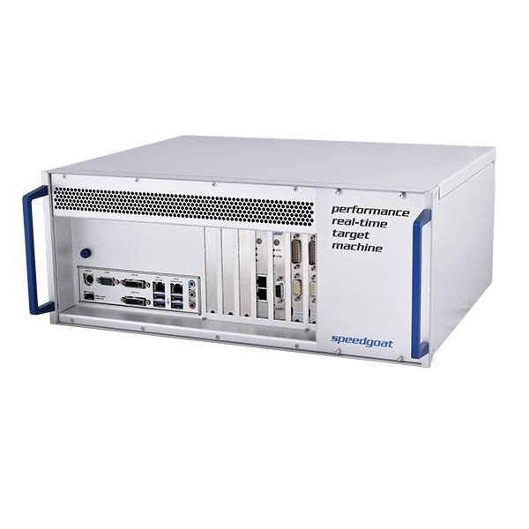
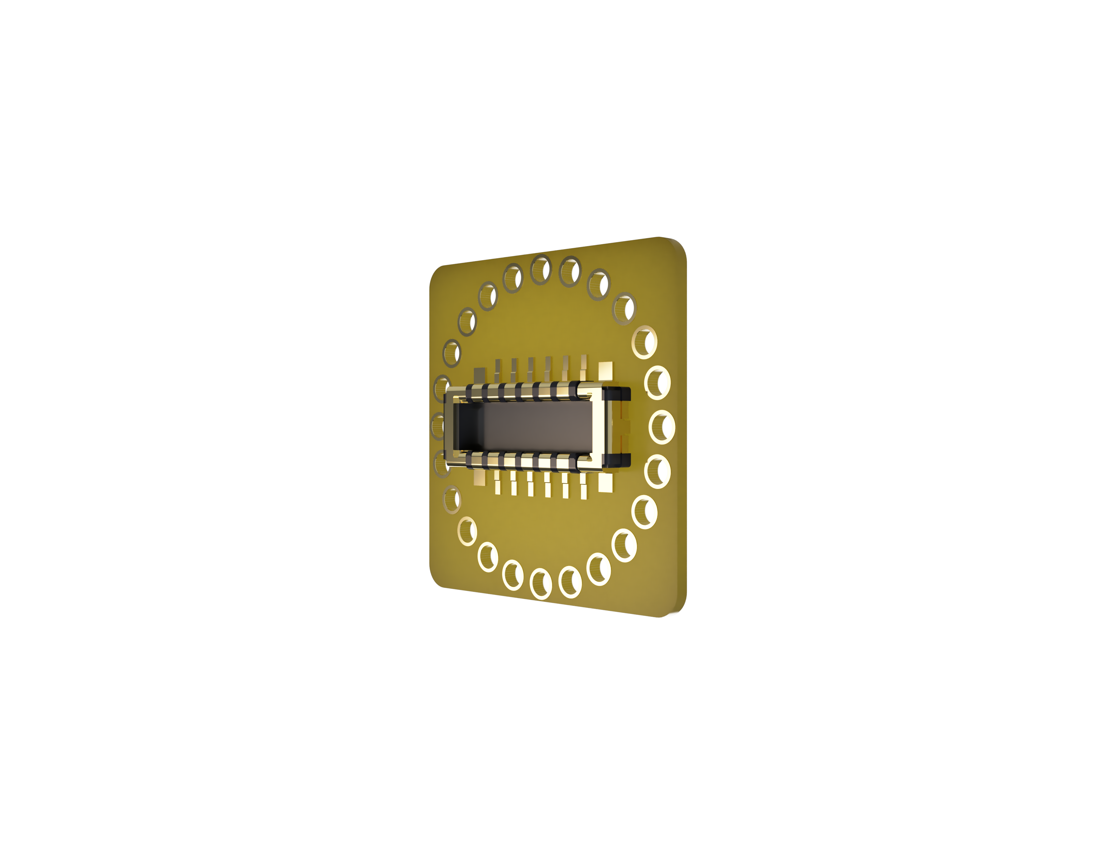
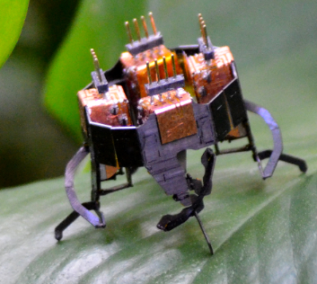
Millimeter-Scale Robot Cable Concept
Cable connects test equipment to mm-scale robot with easy mezzanine connector
Mezzanine connector (to robot flex PCB)
Mezzanine connector (to test hardware)
Thru-hole Vias for soldering magnet wire
Test Hardware
20-24 strand, 46 AWG magnet wire
Mm-scale Robot
Flex PCB (5x5mm)
Flex PCB (5x5mm)
Note: Rendered connector only has 12 pins. Actual PCB will have 20 or 24 pin connector.

